Slide 1
A High-Level Comparison of Photo-z Codes on Luminous Red Galaxies
Manda Banerji (UCL)
Filipe Abdalla (UCL), Ofer Lahav (UCL), Valery Rashkov (Princeton)
Photometric Redshift Accuracy Testing Workshop, JPL, Pasadena, 03/12/08-05/12/08

Slide 2
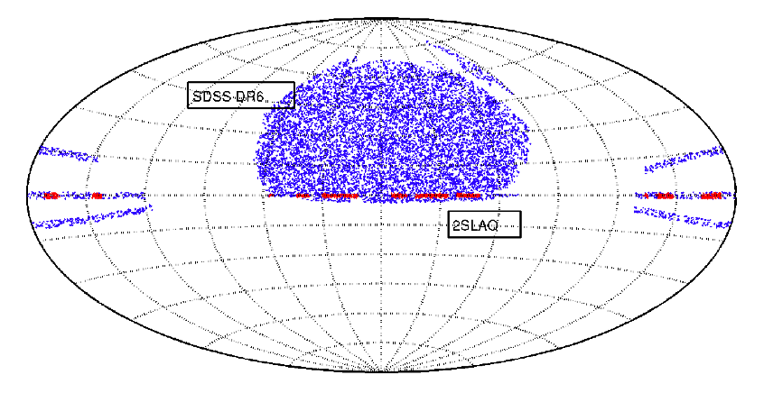
Data - 2SLAQ & MegaZLRG
Data_x0003_
Methods_x0003_
Results
Lessons_x0003_
2SLAQ - 2dF and SDSS LRG and QSO Survey (Cannon et al., 2006)
Spectroscopy of ~13,000 Luminous Red Galaxies (LRGs) in the redshift range 0.3<z<0.8 - 5482 of these are used in this comparison.
LRGs specifically chosen due to their good photo-z’s (strong Balmer break)
Photometric redshift catalogue constructed from SDSS DR4 photometry using neural network code ANNz with 2SLAQ spectroscopic redshifts as a training set - MegaZLRG - 1,214,117 objects (Collister et al., 2007)

Slide 3
Method
Data_x0003_
Methods_x0003_
Results
Lessons_x0003_
Caveats :
We only use codes as they are in their public release. We are aware that many codes have been subsequently improved by their authors but are yet to be publicly released in this form.
We optimise parameters to the best of our ability given information in the public documentation. We do not modify the source code in any way. The philosophy behind this work is to assess not only how accurate a photo-z code is but also its “user friendliness” - i.e. how easily can it be used by a random member of the community using only information in the public docs.
Take public (web)
version of code
Use only template
SEDs
supplied with code
Optimise params
according to
info in public doc
No
Calculate photo-z
for all LRGs in
SDSS DR6
Compare with
available zspec.
Reasonable?
Calculate photo-z
For 2SLAQ
Yes

Slide 4
Photo-z Estimators
Data_x0003_
Methods_x0003_
Results
Lessons_x0003_
Template
  Simple Likelihood Fit - e.g. HyperZ, and LePhare
  Use of Bayesian priors - e.g. BPZ
Training
  Use of a training set with spectroscopic redshifts to find empirical relation between redshift and colour. e.g. ANNz
Hybrid
  Use of a training set with spectroscopic redshifts to adjust templates e.g. SDSS Template code.

Slide 5
Summary of Public Codes
Data_x0003_
Methods_x0003_
Results
Lessons_x0003_
Code | Method | Authors
HyperZ | Template | Bolzonella et al.
BPZ | Bayesian | Benitez
ANNz | Neural Net | Collister & Lahav
ImpZLite | Template | Babbedge et al.
ZEBRA | Bayesian, Hybrid | Feldmann et al.
Kcorrect | Template | Blanton
LePhare | Template | Arnouts & Ilbert
EAZY | Template | Brammer et al.
Notes:
Ways of estimating photometric redshifts fall into two broad categories namely template fitting and empirical methods.
Template fitting methods rely on a set of standard spectral energy distributions like the observed CWW and synthetic BC templates
Training set methods try to find a functional relation between the photometric redshift and some observables such as the magnitude or colour. This is done using training sets where we know the true redshift. Examples of this include polynomial fitting, nearest neighbours and neural networks
We have used a training set method in all our analysis that I will show here

Slide 6
Other methods (not yet public)
Data_x0003_
Methods_x0003_
Results
Lessons_x0003_
Boosted Decision Trees (Gerdes)
Support Vector Machines (Wadadekar)
Kernel Regression (Wang et al.)
Random Forests (Lee Carliles)
Improvements to existing template and hybrid methods e.g. Assef et al. (08), Brimioulle et al. (08), Kotulla et al. (08)
Notes:
Ways of estimating photometric redshifts fall into two broad categories namely template fitting and empirical methods.
Template fitting methods rely on a set of standard spectral energy distributions like the observed CWW and synthetic BC templates
Training set methods try to find a functional relation between the photometric redshift and some observables such as the magnitude or colour. This is done using training sets where we know the true redshift. Examples of this include polynomial fitting, nearest neighbours and neural networks
We have used a training set method in all our analysis that I will show here

Slide 7
Optimising Codes and Templates
Data_x0003_
Methods_x0003_
Results
Lessons_x0003_
CODE | TEMPLATES | TRAINING & PRIOR
HyperZ | 4 x CWW | No Priors
HyperZ | 8 x Bruzual & Charlot | No Priors
BPZ | 17 x interpolated CWW | Flat prior on L
ANNz | None | Training & validation sets
ZEBRA | Optimised E, Sbc and Scd with σ=2, ρ=0.05 | Training set + prior calculated from it
SDSS | Optimised evolving BC burst | Training set to correct template
LePhare | 8 x Poggianti | No Priors

Slide 8
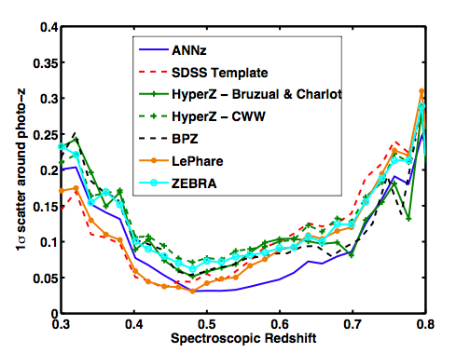
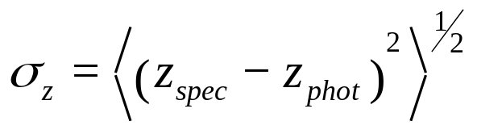
1σ scatter around photo-z
Data_x0003_
Methods_x0003_
Results
Lessons_x0003_
Code + Library comparison
Luminous Red Galaxies so good photo-z
Training set method performs best at intermediate z - lots of galaxies
Template methods that don’t use CWW perform best at low and high-z
Abdalla, MB, Lahav & Rashkov
To be submitted

Slide 9
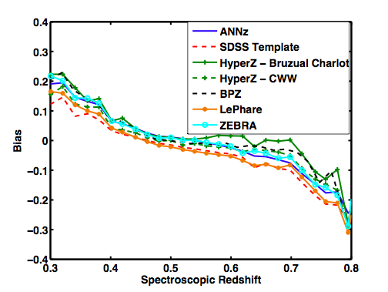
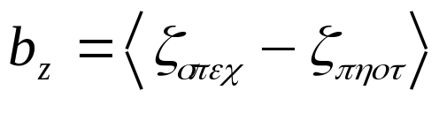
Bias vs spec-z
Data_x0003_
Methods_x0003_
Results
Lessons_x0003_
  Bias typically large at low and high spec-z for all codes
Abdalla, MB, Lahav & Rashkov
To be submitted

Slide 10
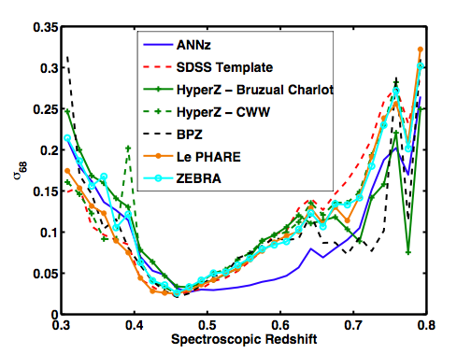
σ₆₈ vs spec-z
Data_x0003_
Methods_x0003_
Results
Lessons_x0003_
Interval in which 68% of galaxies have the smallest difference between their spectroscopic and photometric redshifts
Abdalla, MB, Lahav & Rashkov
To be submitted

Slide 11
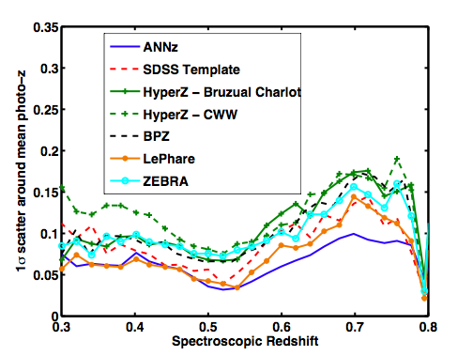
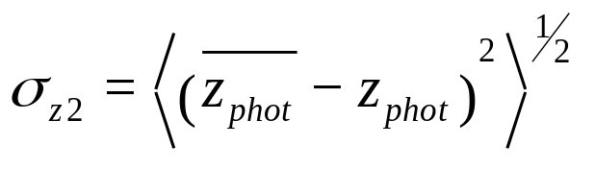
1σ scatter around mean photo-z
Data_x0003_
Methods_x0003_
Results
Lessons_x0003_
Taking moment about mean photo-z in each spec-z bin
At low-z same code (HyperZ) used with two different template SEDs produces very different results
Abdalla, MB, Lahav & Rashkov
To be submitted

Slide 12
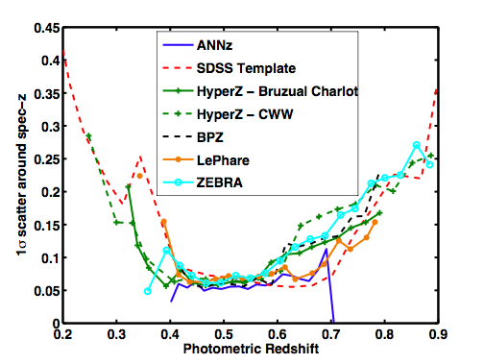
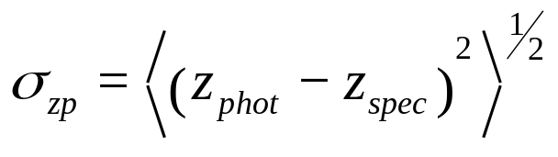
1σ scatter around spec-z
Data_x0003_
Methods_x0003_
Results
Lessons_x0003_
Looking at scatter around spectroscopic redshift in each photo-z bin
Abdalla, MB, Lahav & Rashkov
To be submitted

Slide 13
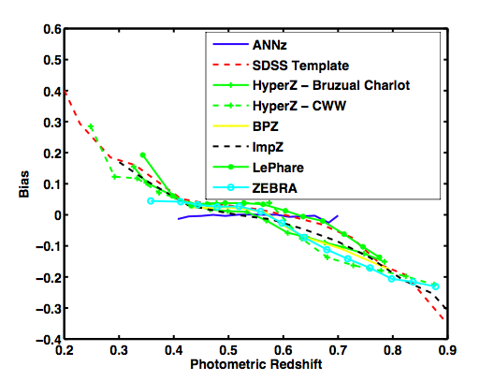
Bias vs photo-z
Data_x0003_
Methods_x0003_
Results
Lessons_x0003_
Training method is virtually free of bias as a function of photometric redshift
Abdalla, MB, Lahav & Rashkov
To be submitted

Slide 14
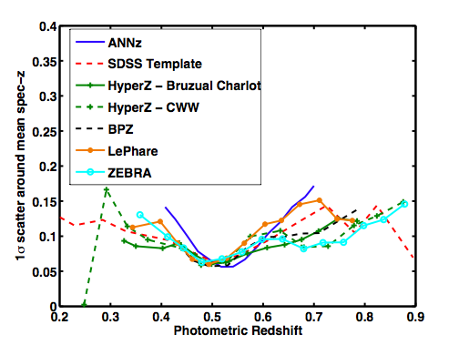
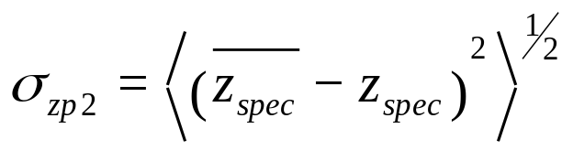
1σ scatter around mean spec-z
Data_x0003_
Methods_x0003_
Results
Lessons_x0003_
Looking at scatter around mean spectroscopic redshift in each photo-z bin
Template codes outperform empirical method
Abdalla, MB, Lahav & Rashkov
To be submitted

Slide 15
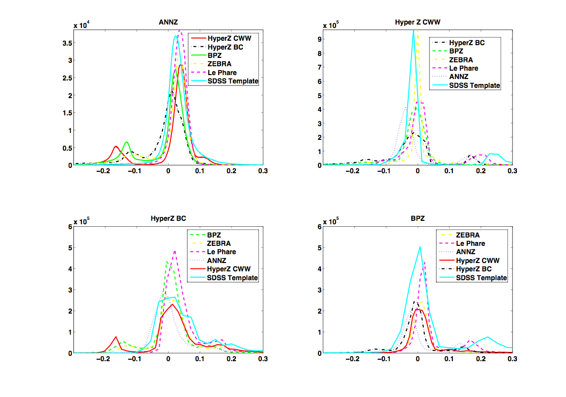
Difference Histograms (I)
Data_x0003_
Methods_x0003_
Results
Lessons_x0003_

Slide 16
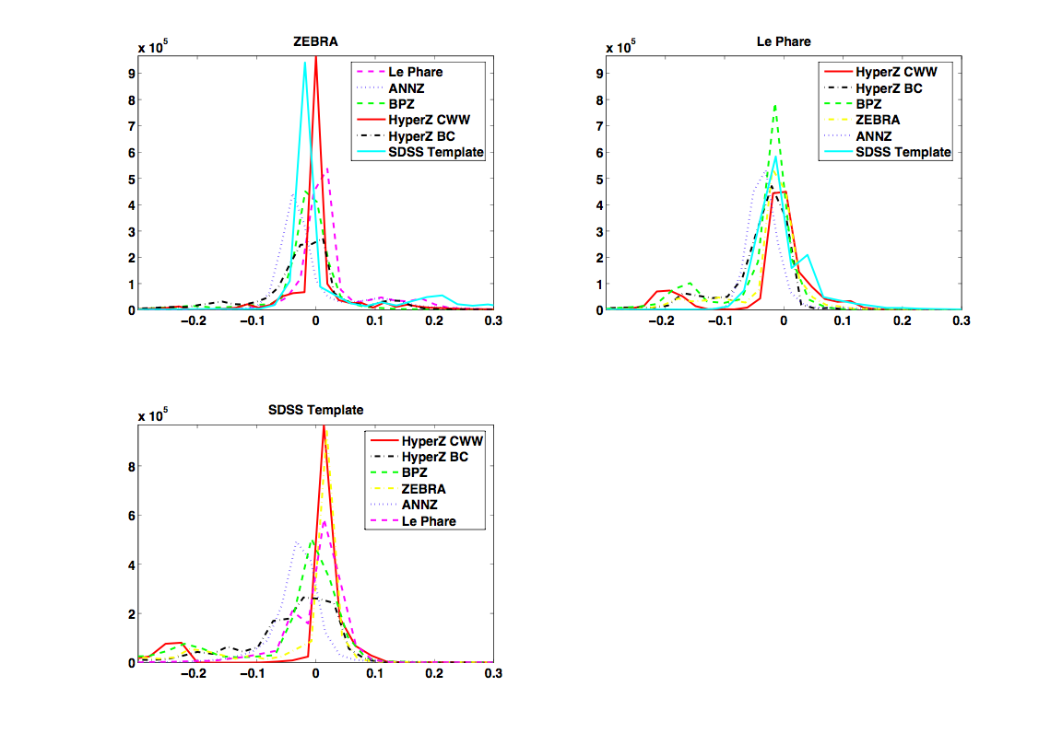
Difference Histograms (II)
Data_x0003_
Methods_x0003_
Results
Lessons_x0003_

Slide 17
Average scatter and bias
Data_x0003_
Methods_x0003_
Results
Lessons_x0003_
Code | Average σ_{z} | Average b_{z}
HyperZ CWW | 0.0973 | -0.0076
HyperZ BC | 0.0862 | 0.0160
ANNz | 0.0575 | 0.0014
BPZ | 0.0933 | 0.0112
ZEBRA | 0.0898 | 0.0013
SDSS Template | 0.0808 | -0.0264
LePhare | 0.0718 | -0.0302

Slide 18
Effect of Photo-z Errors
Data_x0003_
Methods_x0003_
Results
Lessons_x0003_
COSMOLOGY
Various statistical errors in photometric redshift will translate into statistical errors in our estimates of cosmological parameters
Exact effect of these errors will depend on cosmological probe
GALAXY EVOLUTION
Galaxy evolution effects extremely important especially if we want to use photo-z to study galaxy evolution - e.g. local CWW templates are clearly not a good match to LRG spectra

Slide 19
MegaZ LRG DR6
Data_x0003_
Methods_x0003_
Results
Lessons_x0003_
Catalogue of ~1.5 million LRGs from SDSS DR6 with multiple photo-z estimates from different public codes as well as errors on these.
Useful for studies of cosmology as well as galaxy evolution
Soon available from: http://zuserver2.star.ucl.ac.uk/~mbanerji/MegaZLRGDR6/megaz.html

Slide 20
Next Steps
Data_x0003_
Methods_x0003_
Results
Lessons_x0003_
Need for low-level comparison to disentangle effects of library templates and algorithm - PHAT!
Different statistics show different codes up in a better light so important to compare catalogues directly
Template-based methods should provide more than one set of basis SEDs for use e.g. LePhare
Codes need to be simple, transparent and easy to use by other members of the community e.g. HyperZ. Best to avoid addition of too many free parameters.

Slide 21
Next Steps
Data_x0003_
Methods_x0003_
Results
Lessons_x0003_
Error estimates for similar codes need to be standardized, e.g. 68% confidence limit
Need for training set methods like ANNz to provide a full probability distribution
Some way of clipping and removing outliers is helpful e.g. odds parameter in BPZ, photo-z error in ANNz
Methods for incorporating incomplete spectroscopic calibration sets in training and hybrid methods
This talk entirely about photo-z’s for field galaxies. Also important to consider photo-z’s for clusters, SN,… will need to be optimised differently

